Slide 2
Introduction to Django
1-Introduction
2-Get Started With Django
3-Write a Django App
4-Basic Concepts
5-Intermediate Concepts
6-Summary

Slide 3
Useful skills/knowledge Python skills:
• Functions, lists, and dictionaries
Using external packages
• Creating classes
• Inheriting classes
Decorators
Working with databases and SQL
HTML and CSS
HTTP requests

Slide 4
Introduction
Overview of Django

Slide 5
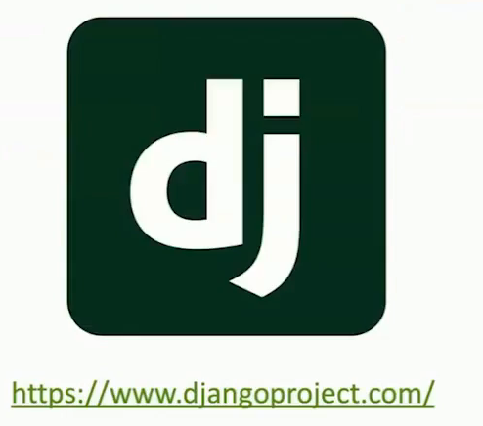
Meet Django
Build features fast
Security built-in
Scales in size well
Built in Python

Slide 6
Meet Django
Web framework written in Python
Full featured
-Security
-Admin
-Sessions
-User management
Used by many big websites / web apps

Slide 7
Websites who use Django
Instagram
Spotify
YouTube
The Washington Post
The New York Times
The Guardian
NASA Website
DoorDash
Udemy

Slide 8
Python Web Framework Alternatives
For simpler/single page websites
- Consider Flask
For API's
-Consider FastAPI
For when speed and developer resources are tight
-Consider Anvil

Slide 9
History of Django
Started in 2003 by Adrian Holovaty and Simon Willison (and later, Jacob Kaplan Moss) at a newspaper company in Kansas
Released as open-source in 2005, and named after the jazz guitarist, Django Reinhardt
Built to create things fast, under deadlines, with many non- developers, like content creators

Slide 10
Overall architecture
Uses an MVT pattern:
Models
Interact with the database via an ORM
• Views
Handle HTTP requests and return responses
• Templates
Create dynamic HTML pages from Python data

Slide 11
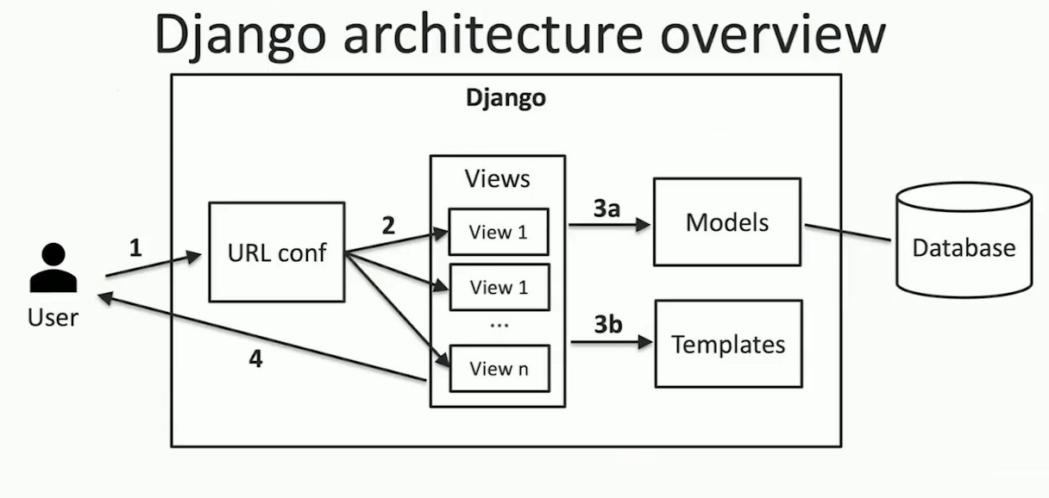

Slide 12

Django architecture
1-user sends an HTTP request to Django

Slide 13
Django architecture
1-user sends an HTTP request to Django
2-URL configuration , contained in urls.py,
selects a View to handle the request

Slide 14
Django architecture
1-user sends an HTTP request to Django
2-URL configuration , contained in urls.py,
selects a View to handle the request
3-The View gets the request and
a) Talks to a database via Models
b) Renders an HTML
Template

Slide 15
Django architecture
1-user sends an HTTP request to Django
2-URL configuration , contained in urls.py,
selects a View to handle the request
3-The View gets the request and
a) Talks to a database via Models
b) Renders an HTML
Template
4-The View returns an HttpResponse which gets sent to the client to be redered as a web page in the browser

Slide 16
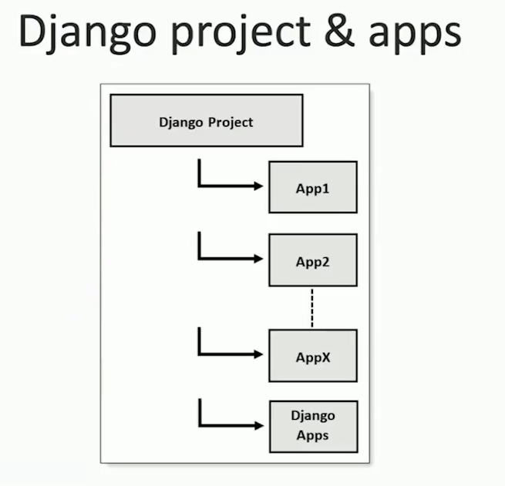

Slide 17
Get started with Django

Slide 18
Before you start
Choose a Django version
Choose a compatible Python version
Create project folder
Create a virtual environment with Python version

Slide 19
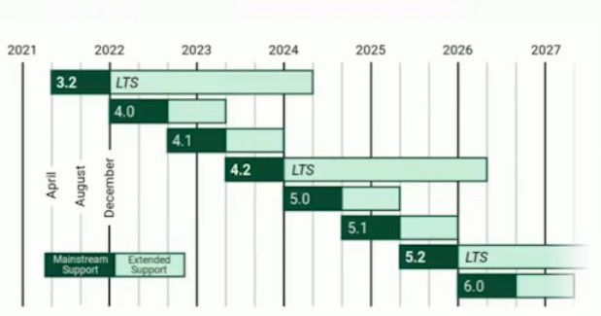
Choose a Django version
Use an older version if you're running an existing project that hasn't been migrated yet
Otherwise, use the latest X.2 release or the newest version
X.2 will have long term support (ITS)

Slide 20
Choose a Django version
4 is very similar to 3
4 uses zoneinfo instead of pytz
We're going to use 4.2 Support for Async/ASGl started in 3.0 and is ongoing

Slide 21
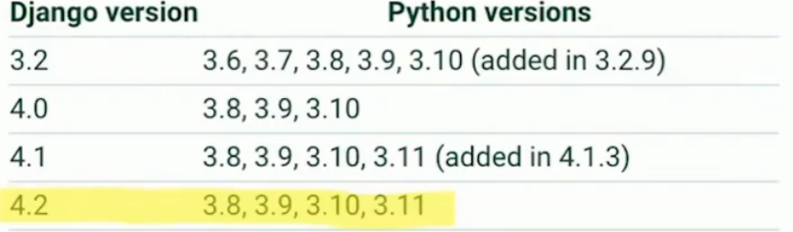
Choose a Python version
What Python version can I use with Django ?

Slide 22
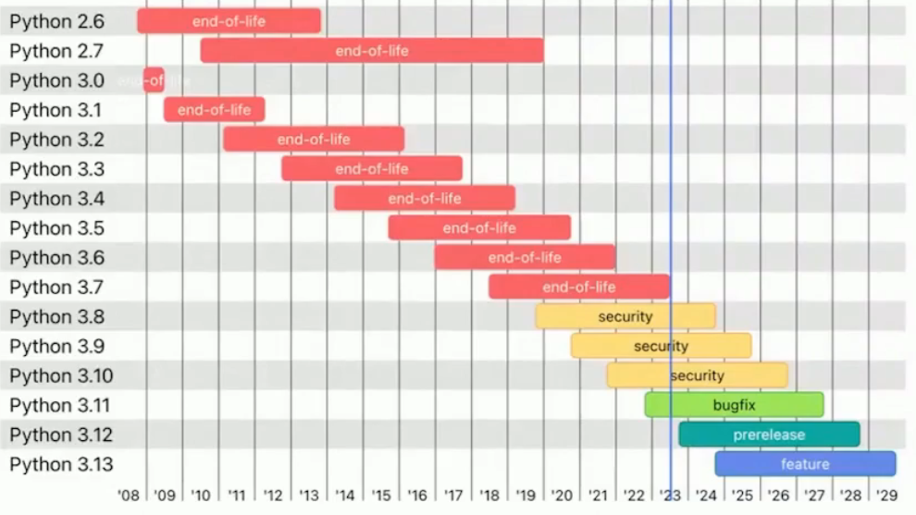
Choose a Python version
Python release cycle

Slide 23
Create a virtual environment
Example for Linux/Mac
$ cd Documents/project-folder-name
-navigate into project folder
$ python3.13 –m venv venv
-create a virtual environment
$ source venv/bin/activate
-activate virtual environment

Slide 24
Create a virtual environment
Example for Windows
$ cd Documents/project-folder-name
-navigate into project folder
$ python3.13 –m venv venv or py –m venv venv
-create a virtual environment
$ venv/bin/activate.ps
-activate virtual environment

Slide 25
Why create a virtual environment?
You may have multiple Python versions on your computer
You may have projects that require different versions of the same external package
Virtual environments create a "workspace" environment for a specific project
- All installed apps are in one place, without conflicts
- The "python" and "pip" commands point to the same place
-Keeps your environment clean

Slide 26
Create a Django project
Install Django using pip
Create a new project using django—admin startproject
Run the development server
Initialize the development database
Create a superuser
View the admin site

Slide 27
Install Django using pip
In your activated virtual environment, use one of the following:
$ pip install django
-Latest version of Django (any version)
$ pip install "django>=4.2.<5"
-Latest version of Django 4.2
$ pip install "django==4.2.3“
-Specific version of Django

Slide 28
Create a new Django project
$ django—admin startproject <project_name>
This will create a new folder with project _ name and the following structure (if project name is test_project)
test_project
.manage.py
. test_project
. _init_. Py
.settings . Py
.urls.py
.wsgi. Py
.asgi.py (only in Django 3+)

Slide 29
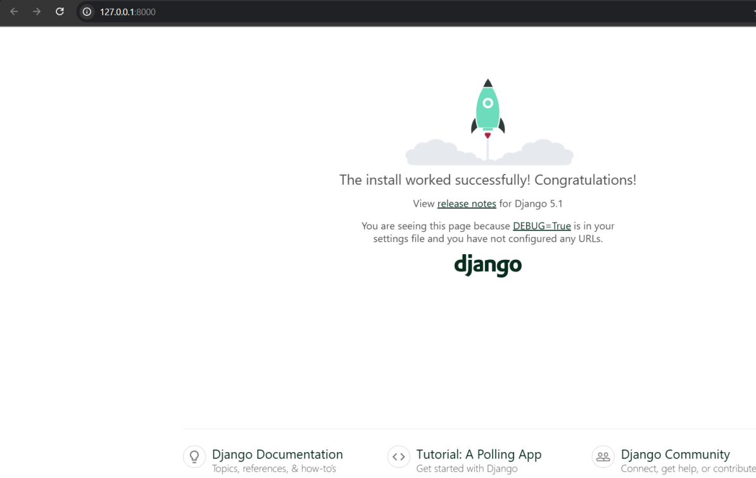
Run the development server
$ python manage.py runserver
Open http://127.0.0.1:8000/ or http://localhost:8000/ in your browser

Slide 30
Run the development server
Now open http://127.0.0.1:8000/admin

Slide 31
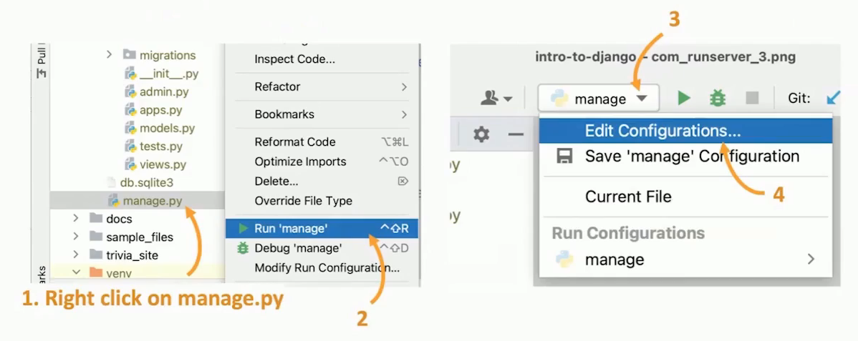
Run the server through PyCharm

Slide 32
Initialize the development database
$ python manage.py migrate
This will initialize a SQLite database (db.sqlite3) with the tables specified in the default project:
• authorization tables (user, permissions, groups)
django_migrations
django_admin_log
django_sessions
django_content_type

Slide 33
Initialize the development database
You can edit the database type and default tables by editing the settings. py file
django_migrations
- required for Djangols ORM feature
authorization tables (user, permissions, groups)
-default user and permissions features
django_admin_log
-tracks changes made via the Django Admin
django sessions
-used in the sessions app (e.g. cookies)
django_content_type
-used for generic model relations (like tags, comments, likes, etc)

Slide 34
View the data in the database
Command line interface
An app • e.g. DB Browser for SQLite or SQLiteStudio
A website • e.g. https://inloop.github.io/s+-viewer/
PyCharm Professional (built-in)
PyCharm Community • plugin: Database Navigator
VS Code extension
• plugin: SQLite

Slide 35
Create a superuser
$ python manage.py migrate
Creates your first user so that you can log into the admin site
You supply :
Username
Email address
Password
-You can bypass the password requirements

Slide 36
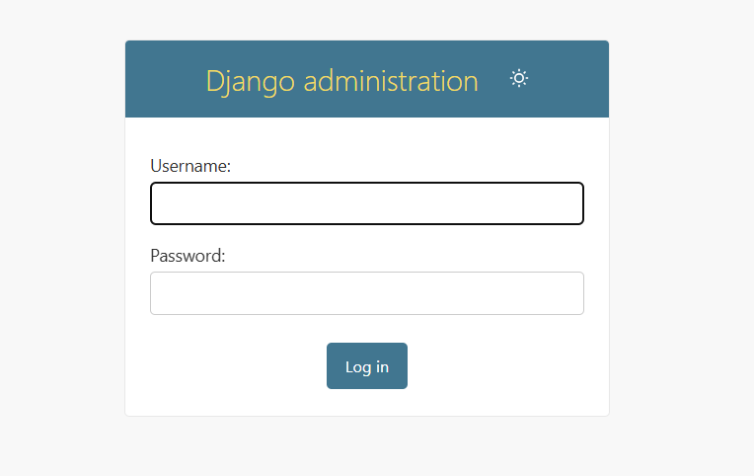
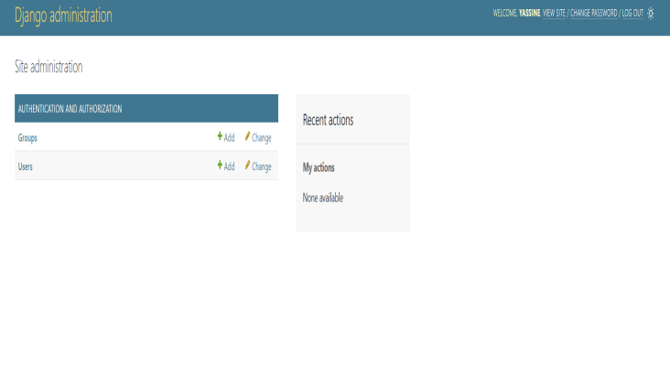
View the admin site
Make sure your server is running
- $ python manage.py runserver
Open http://127.0.0.1:8000/admin
Log in using your superuser credentials
You can now browse,create,edit,and delete your Django models
-only users and groups are configured initially
-we’ll add more later

Slide 37
Default project files

Slide 38
manage.py
Run this file to run the project
-runserver : Run the development server
-migrate : Apply the migrations to the db
-createsuperuse:Create a super user in the db
-shell:Run a python console (has access to Django project)
makemigrations : If models changed, create migration file
Run the file without any arguments to see full list of commands

Slide 39
settings.py
Configures Django settings for your site
Some notable ones:
-DEBUG mode (must turn off in production)
-Database settings (don't use SQLite in production) .
-Installed apps
-Timezone
-Static and media folder locations
-Password validators

Slide 40
urls.py
Defines the URLs for your site
• In the default urls.py urlpatterns = [path(‘admin/’,admin.site.urls),
]
The only URL pattern defined is linking the "admin/" path to the set of admin urls
Try changing the "admin/" path.

Slide 41
wsgi.py and asgi.py
WSGI –Web Server Gateway Interface
During development, you run your web server locally through
- manage.py runserver
In production this is insufficient because it:
-Loads static files slowly
-Only handles one user at a time
-Has not been tested for security
Use WSGI when running in production

Slide 42
wsgi.py
WSGI provides an interface for running your Django application in production with a dedicated web server (like nginx or Apache)
You don't need to know much about web servers and application servers
Just follow tutorials for setting up Django in production and you might end up needing this file

Slide 43
asgi.py
ASGI:Asynchronous Server Gateway Interface
New in Django 3.0
Similar to WSGI but for asynchronous web servers -Allows support for websockets, async and HTTP/2

Slide 44
Create a View

Slide 45
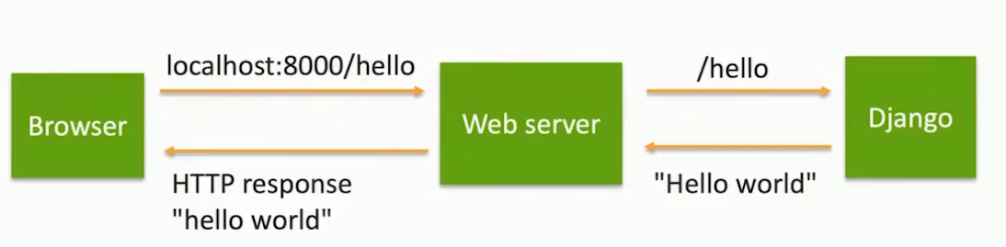
Requests & Responses

Slide 46
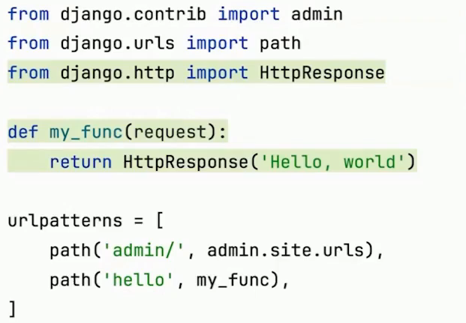
Create a simple view
Create a function that returns an HttpResponse

Slide 47
Create a simple view
Try returning some HTML in the HttpResponse
You’ll see how to return HTML from templates later

Slide 48
Create a simple view
If we put all of our logic in urls.py
-Very Big -Hard to separate functionality -Can't reuse features in other projects
Next we'll look at how to do the same thing in a dedicated app

Slide 49
Basic concepts

Slide 50
Basic concepts
1-Settings

Slide 51
Settings
Provides configuration for your Django project
Default location is settings.py

Slide 52
Settings
Python file, python syntax
Settings are constants
-Use all uppercase
-Reload server if any settings change
Specify the location of your settings file
-In manage.py
-os.environ.setdefault(‘DJANGO_SETTINGS_MODULE, projet_test.settings ' )

Slide 53
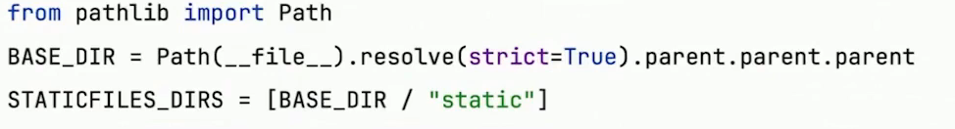
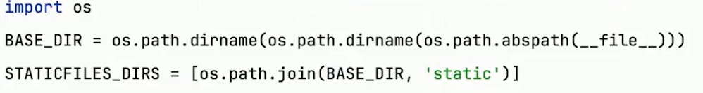
Specifying paths
Django >=3.1
Django <=3.0

Slide 54
Must-know settings
DEBUG
-Show detailed error page vs 404.html or 500.html
-Never set it to True in production
INSTALLED_APPS
-All Django,3rd party and local apps used
DATABASES
-Can configure multiple databases
-Should be different for local,production,staging

Slide 55
Project structure
BASE_DIR
-Set to project root (where manage.py is located)
APP_DIR
-Set to where apps are located
TEMPLATES
-DIRS: Where to look for templates
-APP_DIRS:if True , look for a “templates” folder in each app
STATICFILES_DIRS
-Where to look for static files
MEDIA_ROOT
-Where to look for media files (user_uploaded)

Slide 56
Time zones
USE _Z
-True if dates/times should be timezone-aware by default
-Should set to True
TIME_ZONE : Set it to your time zone
USE_I18N : Enable text translation (set to False if not supported)
USE_L10N : Format data based on locale

Slide 57
Security
AUTH_PASSWORD_VALIDATORS
SESSION_EXPIRE_AT_BROWSER_CLOSE

Slide 58
Basic concepts
2-Django ORM

Slide 59
The Django ORM
Object-Relational Mapping
Manage your data and database with Python and SQL
Lazy evaluation of queries(Database only gets accessed when data is requested, not when forming queries)
Easy things are easy, medium things are possible, hard things can be done in SQL

Slide 60
Schema Update Workflow
Define models with fields and relationships
Create a migration file
$ python manage.py makemigrations
Migrate the database
$python manage.py migrate

Slide 61
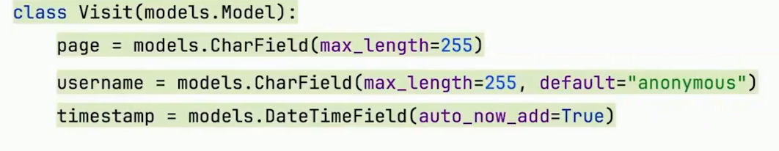
Update the Visits models
Rename models.Visits to Visits so references get renamed
Update models.py

Slide 62
Model fields
Many different model fields are available
Some options are required
E.g. CharField requires max_length
DateTimeField has some special options ,like auto_now_add
Set to the current datatime when added to the db
More options will be discussed later

Slide 63
Migrate the database
Generate a migrations file
-$ python manage.py makemigrations
Migrate the database
-$ python manage.py migrate

Slide 64
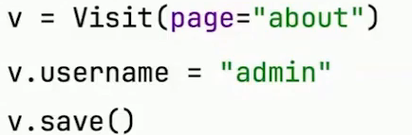
Object creation
Create a new Visit
Create a new Visit and save it in one line

Slide 65
Object retrieval
Get all Visits:
Visit.objects.all()
Get a single Visit:
v=Visits.objects.first()
v.page
Filter Visits:
visits=Visits.obejcts.filter(page=“about”)
visits.count()

Slide 66
Basic concepts
3-Views

Slide 67
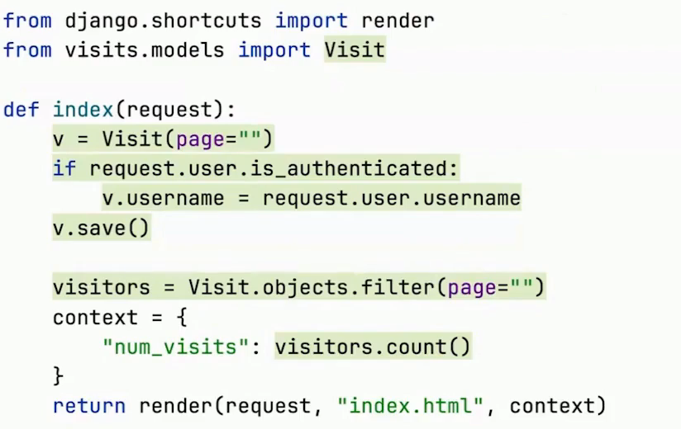
Update view.py

Slide 68
The request object
A view function always accepts an HttpRequest object
• from django.http.request
An HttpRequest has:
• A user (as long as you're using the Django auth middleware)
• Will be an anonymous user if they're not logged in
body — content of the request
• GET/POST — query parameters
Headers — metadata
request URL

Slide 69
View responses
A view function always returns an HttpResponse object
An HttpResponse has:
• A status code (like 200 okay)
Some content (like HTML or JSON)
Some metadata (in headers)

Slide 70
Basic concepts
4-URLs

Slide 71
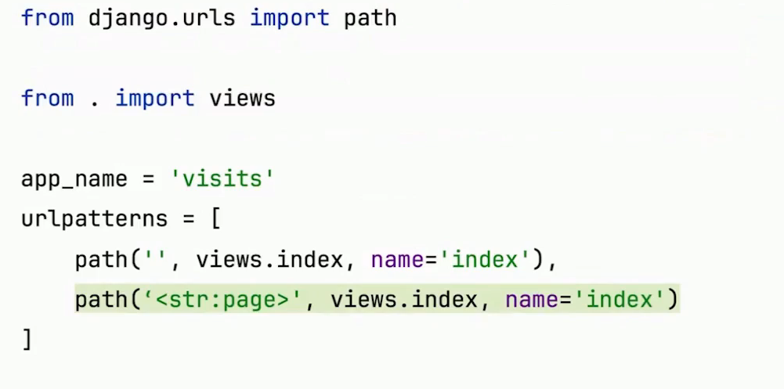
Add a URL pattern to urls.py

Slide 72
Accepting arguments
Use<> to capture URL arguments and pass them to the view
path(‘users/<username>/’,views.profile)
Arguments are strings by default, but you can specify the type
path(‘users/<int:pk>/’,views.profile)

Slide 73
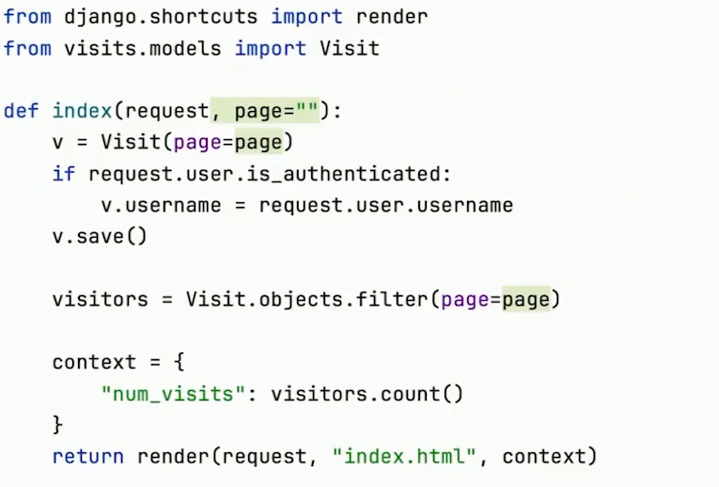
Accepting arguments

Slide 74
Basic concepts
5-Templates

Slide 75
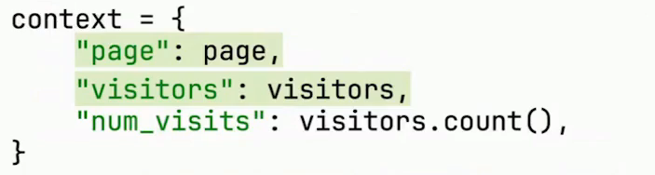
Pass more context in views.py

Slide 76
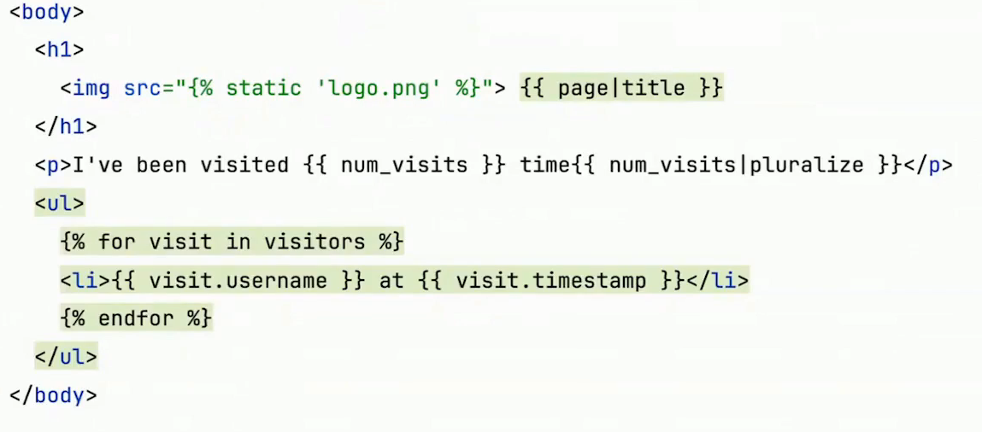
Update the body of index.html

Slide 77
Templates
Templates are just HTML files with special syntax that the
Django Template Language (DTL) uses to replace with dynamic content
Variables: {{ var }}
Filter: {{ var|filter }}
Tag: {% tag %}
Comment: {# comment #}

Slide 78
Basic concepts
6-Admin

Slide 79
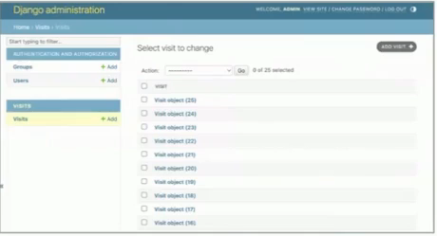
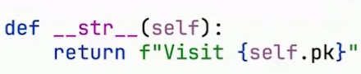
List View
Define a __str__() method
On Visit to customize how
It’s displayed in the admin list view

Slide 80
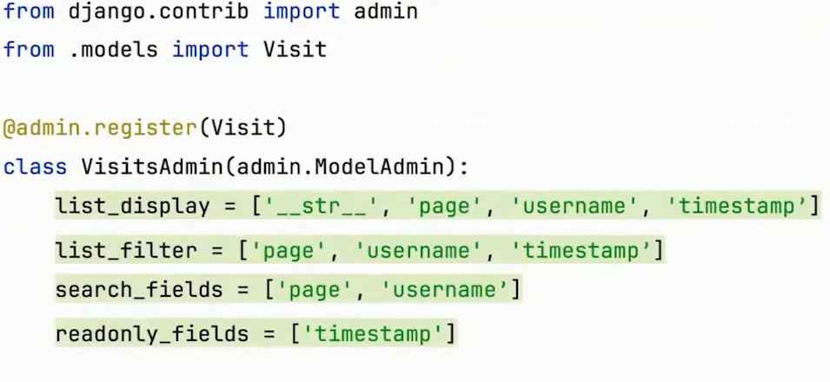
Customizing the List View

Slide 81
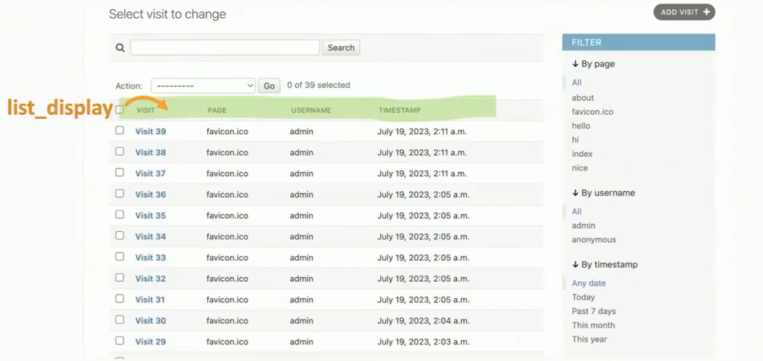
List View Updates

Slide 82
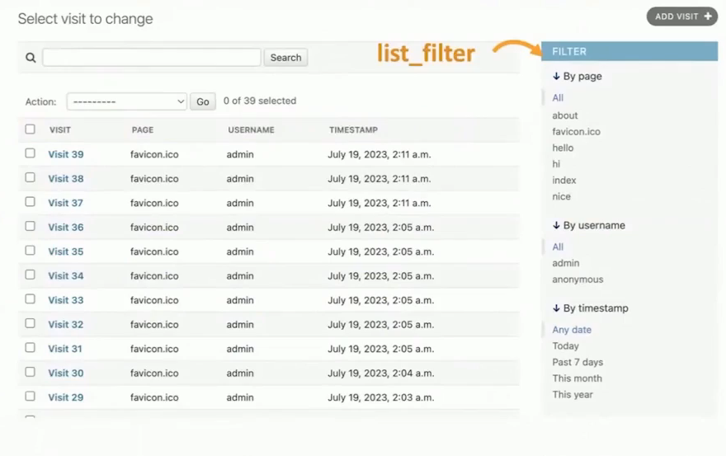
List View Updates

Slide 83
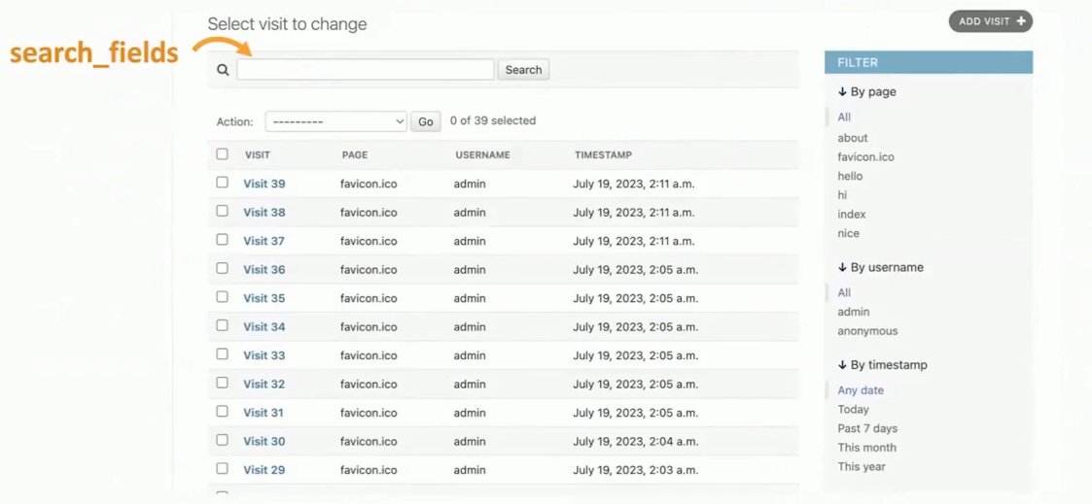
List View Updates

Slide 84
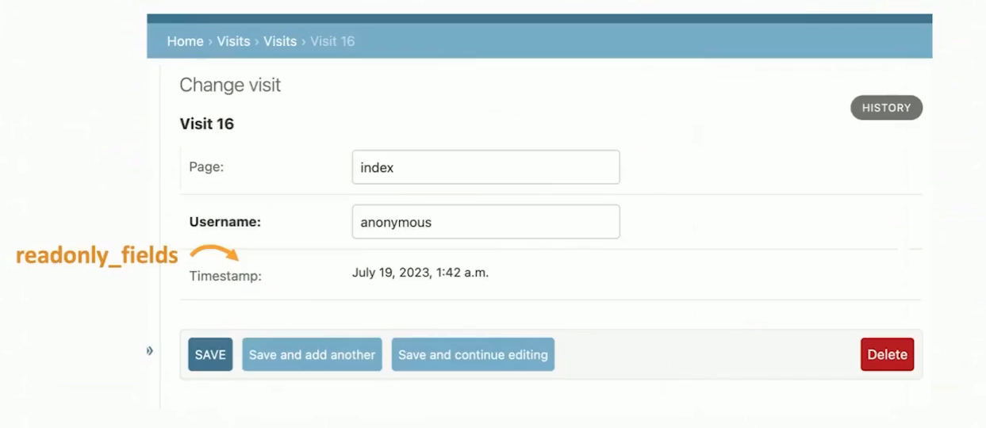
change View Updates

